Slide 1

Energy efficiency
.

Slide 2
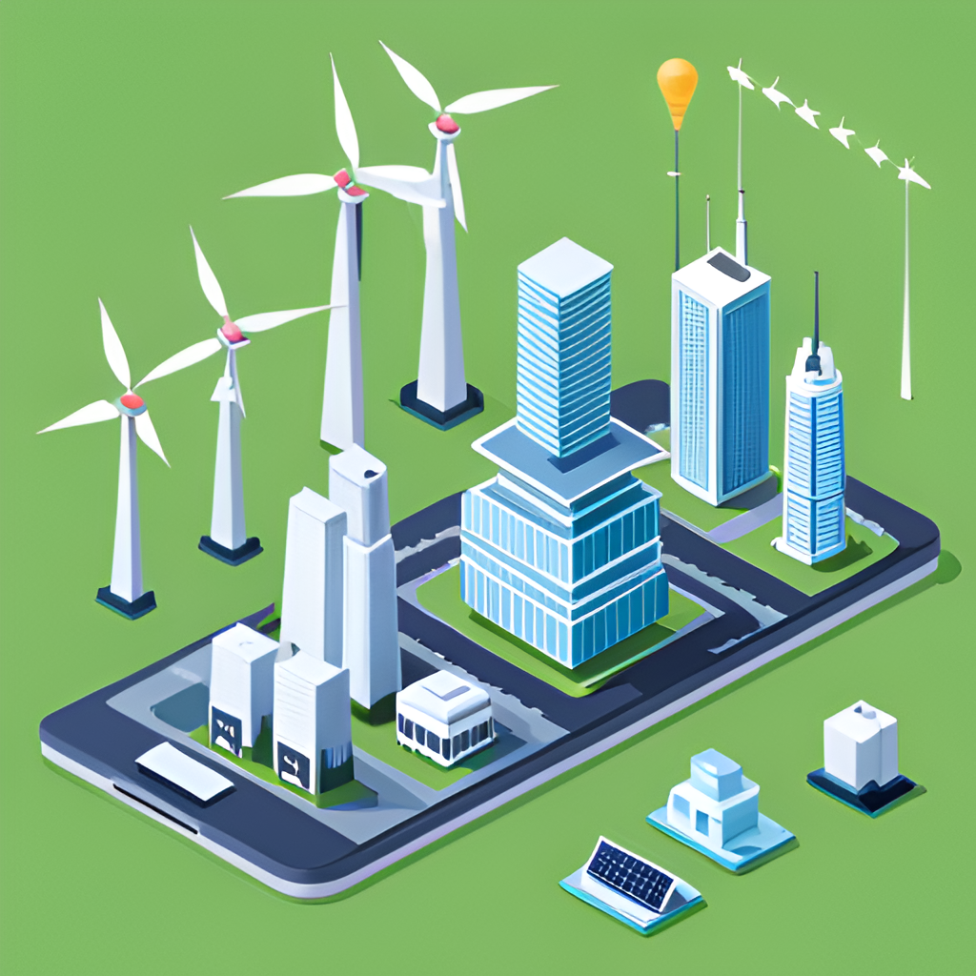
User Details :-
V.Ashish 2203A52059
Trainer :-
D.Ramesh
Asst.professor
CS and AI&ML

Slide 3

Introduction
Welcome to my presentation on "Energy Efficiency Dataset and Machine Learning."
In an era of growing energy consumption and environmental concerns, optimizing energy usage is paramount.
This presentation explores the synergy between machine learning and energy efficiency, focusing on how data-driven insights can revolutionize energy management.
Let's dive into the world of energy datasets and discover how machine learning can drive efficiency, reduce costs, and promote sustainability.

Slide 4

Introduction
Energy efficiency is a crucial issue that affects both individuals and businesses. By using machine learning algorithms, we can optimize energy usage patterns and reduce waste, leading to significant cost savings and a healthier planet.

Slide 5
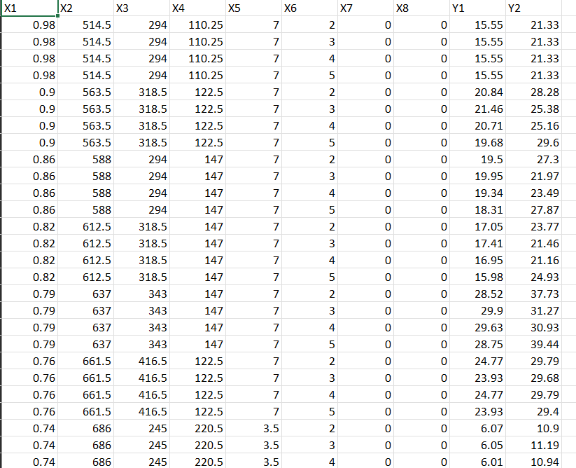
Data-set:-

Slide 6
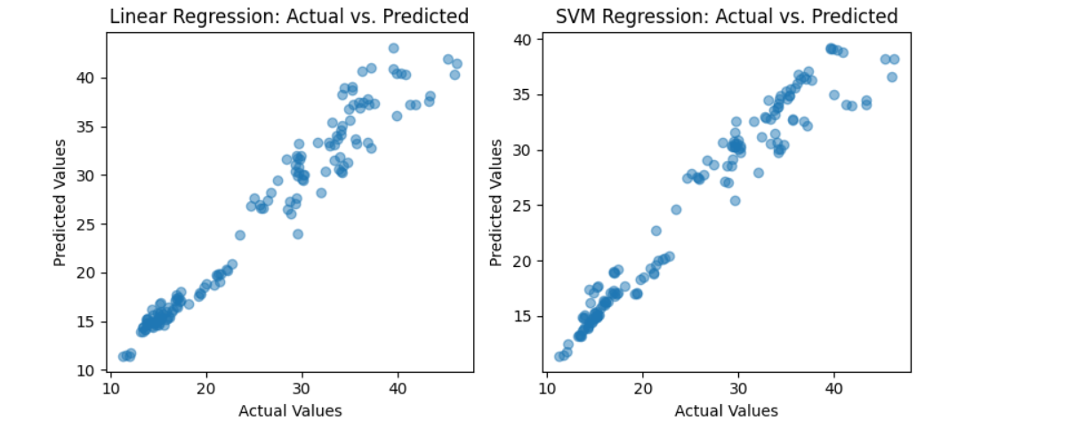
Graph:

Slide 7
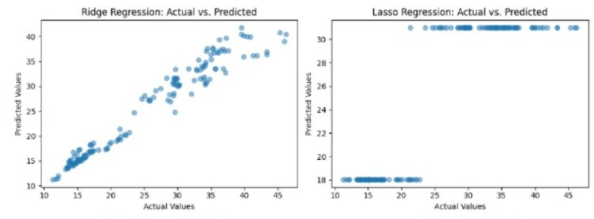
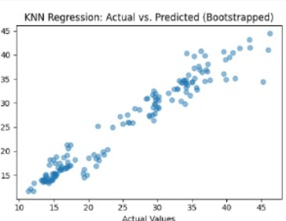

Slide 8
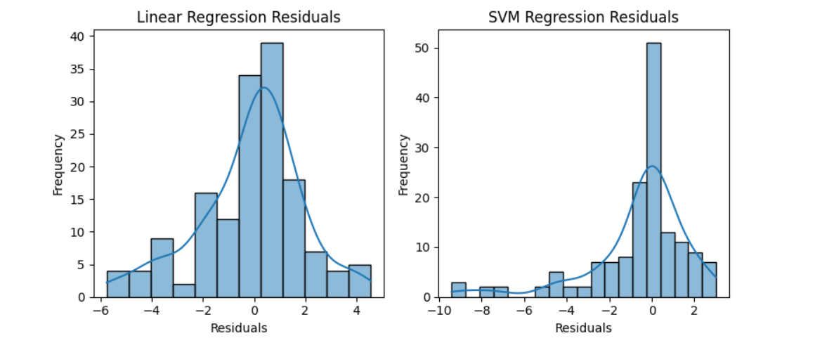
Graph:

Slide 9
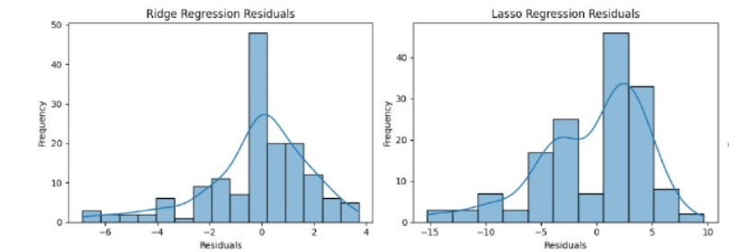
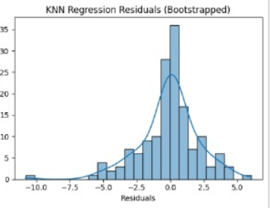

Slide 10

Min-max scaling:-
Min-max scaling, also known as normalization, is a data preprocessing technique commonly used in machine learning to scale numerical features within a specific range, typically between 0 and 1. It involves transforming the values of each feature such that they are linearly mapped to the desired range.

Slide 11

Features and Target variable
Features:
Column 1: Numeric (e.g., 0.76, 0.74, etc.)
Column 2: Numeric (e.g., 661.5, 686, etc.)
Column 3: Numeric (e.g., 416.5, 245, etc.)
Column 4: Numeric (e.g., 122.5, 220.5, etc.)
Column 5: Numeric (e.g., 7, 3.5, etc.)
Column 6: Numeric (e.g., 5, 2, etc.)
Column 7: Numeric (e.g., 0.4)
Column 8: Numeric (e.g., 2, 3, etc.)
Column 9: Numeric (e.g., 40.42, 14.54, etc.)
Column 10: Numeric (e.g., 39.7, 16.43, etc.)
Target Variable:
Column 11: Numeric (e.g., 39.7, 16.43, etc.)
Based on this analysis, it appears that the first 10 columns (Columns 1 to 10) are potential features, and Column 11 is the likely target variable that you want to predict or model. The features (Columns 1 to 10) contain various numerical values, while the target variable (Column 11) also consists of numerical values.

Slide 12
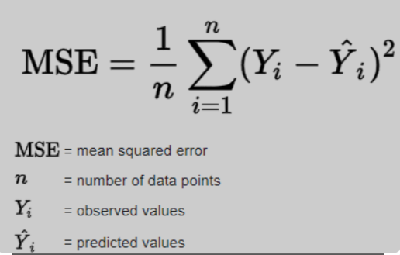
Mean Squared Error(MSE):-
The MSE is computed as the average of the squared differences between predicted and actual values

Slide 13

Linear Regression
Linear regression is a type of supervised machine learning algorithm that computes the linear relationship between a dependent variable and one or more independent features.
Output:

Slide 14

Support Vector Machine (SVM)
A support vector machine (SVM) is a type of supervised learning algorithm used in machine learning to solve classification and regression tasks
Output:

Slide 15
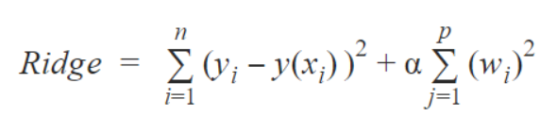
.
Ridge regression :-
Ridge regression is a term used to refer to a linear regression model whose coefficients are estimated not by ordinary least squares (OLS), but by an estimator, called ridge estimator, that, albeit biased, has lower variance than the OLS estimator
Out put:

Slide 16
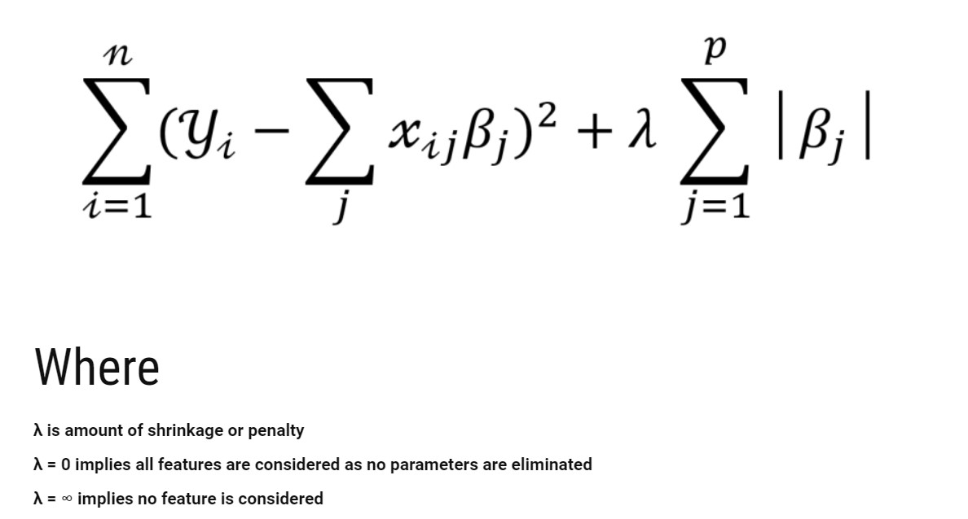
Lasso regression:-
Lasso regression is a regularization technique. It is used over regression methods for a more accurate prediction. This model uses shrinkage. Shrinkage is where data values are shrunk towards a central point as the mean. The lasso procedure encourages simple, sparse models (i.e. models with fewer parameters).
Out put:

Slide 17
KNN with bootstrap:-
K-Nearest Neighbors (KNN) with bootstrapping is a resampling method that enhances the reliability of KNN models. It involves repeatedly selecting random subsets of the training data with replacement. This process creates multiple datasets, allowing KNN to make predictions on each one and then aggregate the results, which can lead to improved model performance, reduced overfitting, and better generalization on diverse subsets of the data.
Out put:

Slide 18
GitHub Link:-
https://github.com/spideyy36/project-stat-ml.git

Slide 19


